Slide 1
SOCIAL JUSTICE RESPONSES TO COVID-19
Address to the Waterfront Rotary Club
PROF THULI MADONSELA: CHAIR IN SOCIAL JUSTICE STELLENBOSCH UNIVERSITY, SOCIAL JUSTICE M-PLAN CONVENER
12 June 2020

Slide 2
OVERVIEW
Acknowledgements
The COVID-19 Lens on a Promise Betrayed
Why is Social (In)justice Our Problem?
What Has Gone Wrong?
When You Can Only Do Little
A Social Justice Paradigm
The M-Plan Way
The Next Chapter
Gratitude

Slide 3
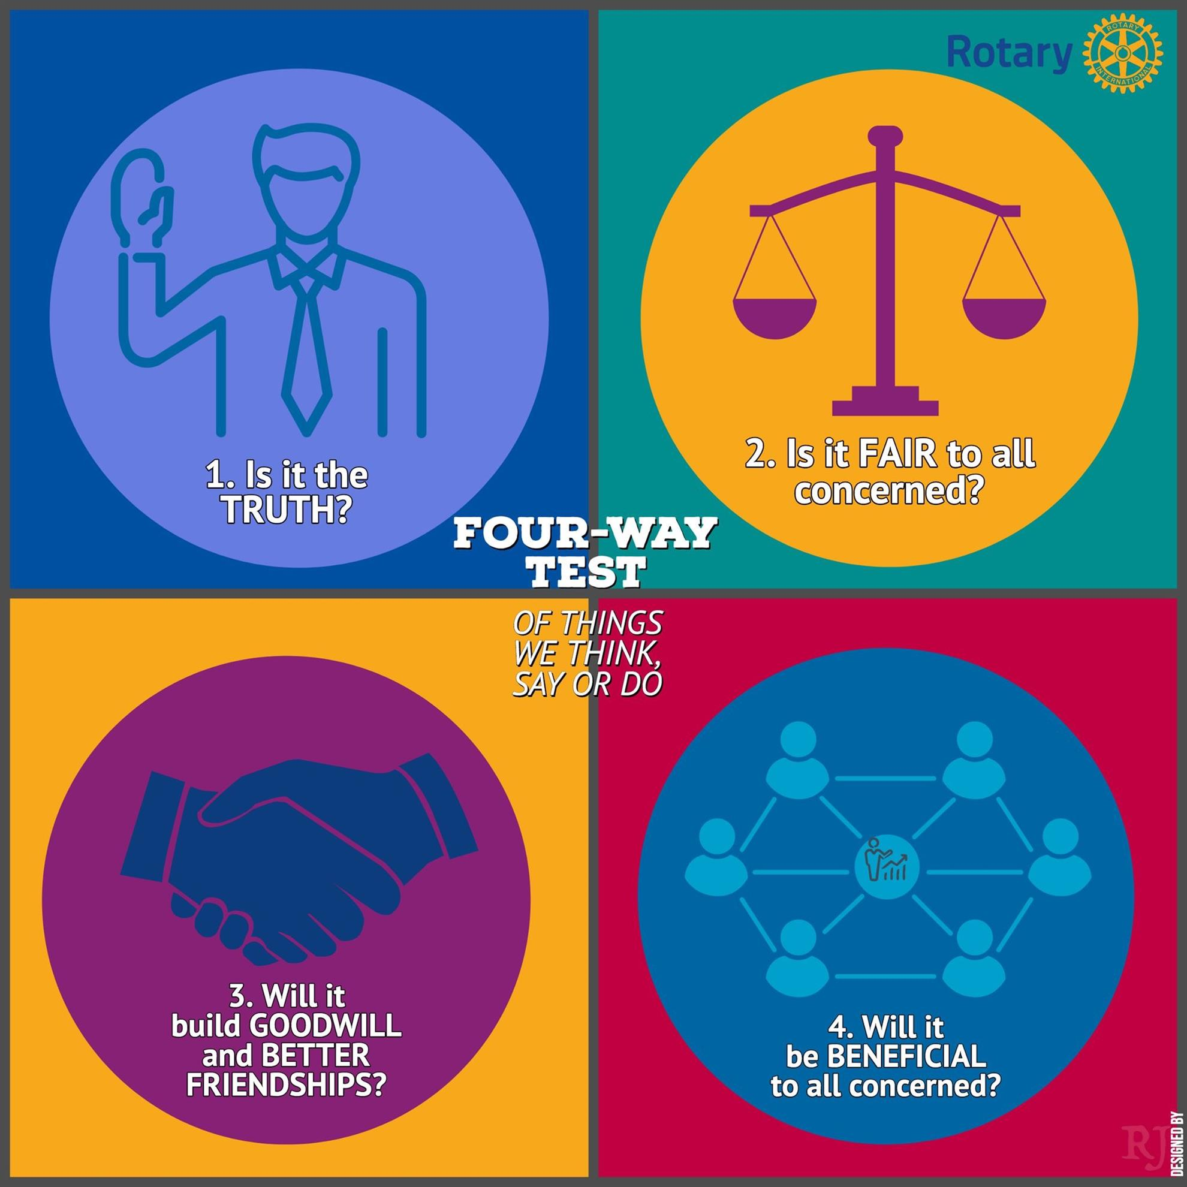
ACKNOWLEDGEMENTS

Slide 4
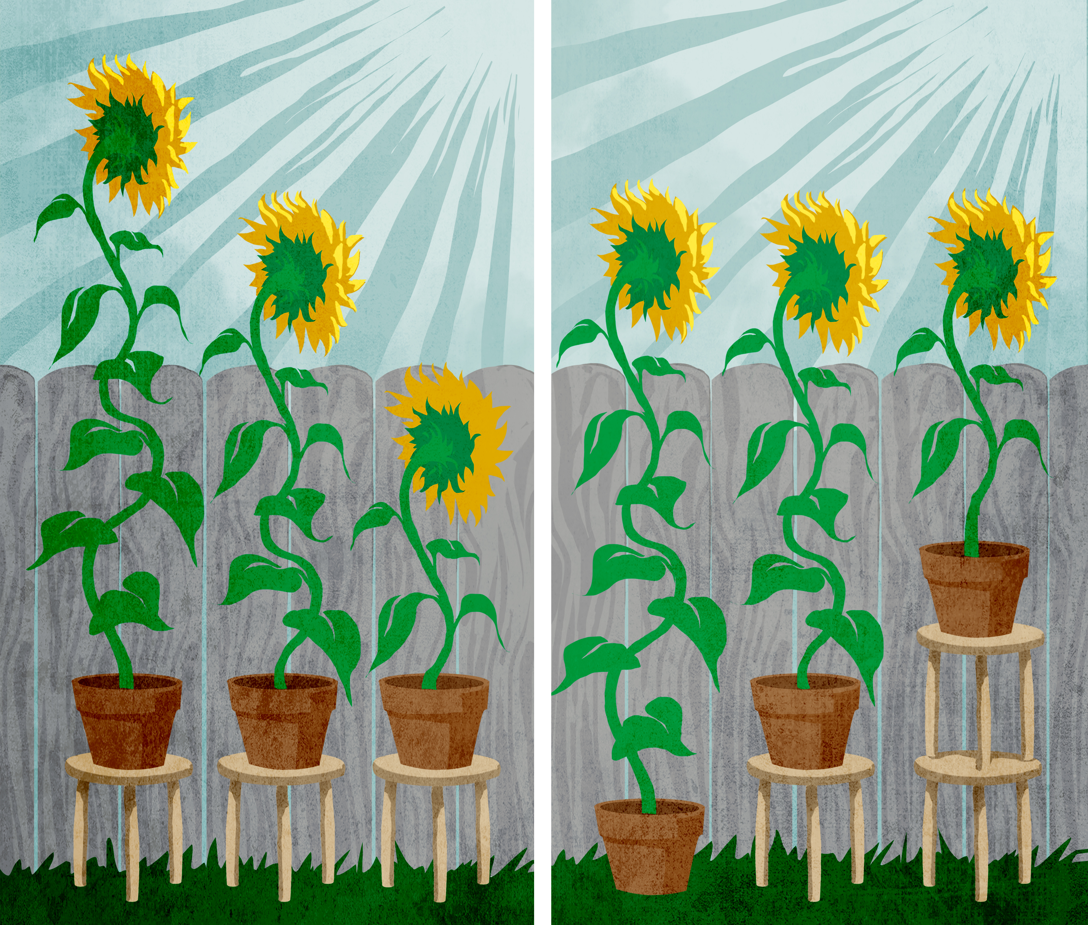
THE COVID-19 LENS ON A PROMISE BETRAYED

Slide 5
THE COVID-19 LENS ON A PROMISE BETRAYED
We, therefore, through our freely elected representatives, adopt this Constitution as the supreme law of the Republic so as to -
Heal the divisions of the
The Promise of Social Justice
past and establish a society based on democratic values, social justice and fundamental human rights;
Lay the foundation for a democratic and open society in which government is based on the will of the people and every person is equally protected by law;
Improve the quality of of all citizens and free the potential of every person; and Build a united and democratic South Africa able to take its rightful place as a sovereign state in the family of nations.

Slide 6
WHY IS SOCIAL JUSTICE OUR PROBLEM?

Slide 7
WHAT HAS GONE WRONG?

Slide 8
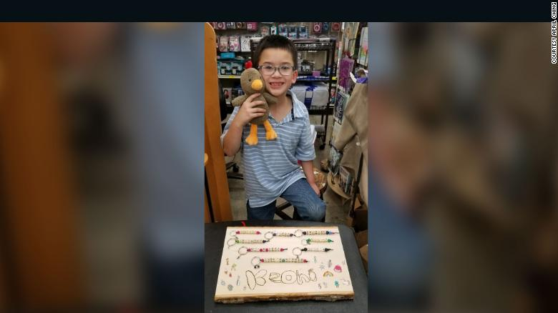
WHEN YOU CAN ONLY DO LITTLE – ROTARY AND KEONI CHING WAY
E

Slide 9
OVERVIEW
8-year-old Keoni Ching, raised the money by making kindness keychains that he sold for $5.

Slide 10
A SOCIAL JUSTICE PARADIGM
Three Rs by Nancy Fraser
Redistribution-Parity of Participation
Recognition-Equal Respect and Opportunity
Representation; Equal Voice

Slide 11
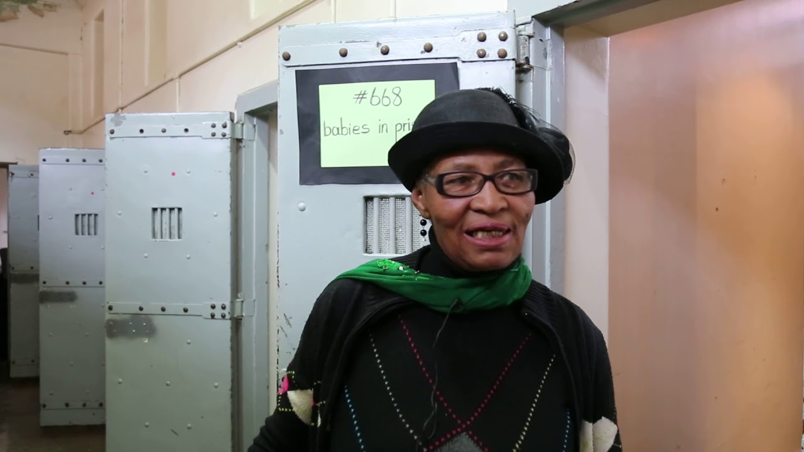
M-PLAN WAY
ALL HANDS ON DECK SYSTEMS & DISRUPTIVE APPROACH
Leveraging data analytics for consciously impactful policy and law
Crowd funding
Social accountability and cohesion
Leadership at all levels

Slide 12
THE NEXT CHAPTER
Every generation has a responsibility and opportunity to improve on what it has inherited to make the next chapter better for humanity and the planet

Slide 13
GRATITUDE
ENKOSI! THANK YOU! DANKIE!

