Slide 1
THE STATE OF OVERSIGHT AND GOVERNMENT COMPLIANCE IN SOUTH AFRICA AND ITS IMPLICATIONS FOR SOCIAL JUSTICE
Prof Thuli Madonsela
Director: Centre For Social Justice Stellenbosch University
Radisson Conference Centre – 19 November 2024

Slide 2
ACKNOWLEDGEMENT AND SYNERGIES
The Centre for Social Justice
is a centre of excellence that undertakes research, innovative policy tools design, training and advocacy to promote social justice scholarship and consciousness, attuned public policy design skills and collaboration to accelerate social justice transformation.
We seek to be a partner of choice for research, innovation, training and advocacy for transformative governance and constitutionalism that progressively fosters
social justice as one of three goals of the Constitution, the others being Democratic Governance and Human Rights with a view to improving the quality of life of all citizens and freeing the potential of all persons as envisaged in the preamble to the Constitution and affirmed in various Constitutional Court Judgements.
We believe that:
As long as there is injustice somewhere there cannot be sustainable peace anywhere.
To be stable and sustainable, democracy must work for all.
There can be no trust without accountability and no democracy without trust.

Slide 3
PUBLIC GOVERNANCE & IN A POLYCRISIS – PERMACRISIS AGE
As the world goes through frequent ‘black swans’ and related turbulences that heighten VUCA and exacerbate existing economic and social disparities, particularly poverty, hunger and inequality, now more than ever, fit for purpose leadership and institutions that are characterized by competence and ethics that include purpose alignment, integrity, stainability consciousness and accountability, are essential. Being capable without integrity and accountability is not enough (Rethinking The Fable of Gimba – Assuring Success)

Slide 4
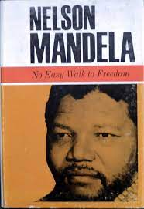
PUBLIC GOVERNANCE & IN A POLYCRISIS – PERMACRISIS AGE: A CONSTITUTION FOR ALL SEASONS
“Even the most benevolent of governments are made up of people with all the propensities for human failings. The rule of law as we understand it consists in the set of conventions and arrangements that ensure that it is not left to the whims of individual rulers to decide on what is good for the populace. The administrative conduct of government and authorities are subject to scrutiny of independent organs. This is an essential element of good governance that we have sought to have built into our new constitutional order. An essential part of that constitutional architecture is those state institutions supporting constitutional democracy. Amongst those are the Public Protector, the Human Rights Commission, the Auditor General, the Independent Electoral Commission, the Commission on Gender Equality, the Constitutional Court and others…
It was to me never reason for irritation but rather a source of comfort when these bodies were asked to adjudicate on actions of my government and office and judged against it. One of the first judgments of our Constitutional Court, for example, found that I, as President, administratively acted in a manner they would not condone. From that judgment my government and I drew reassurance that the ordinary citizens of our country would be protected against abuse, no matter from which quarters it would emanate. Similarly, the Public Protector [Ombudsman] had on more than one occasion been required to adjudicate in such matters.” (Mandela, IOI Conference in Durban, 2000)

Slide 5
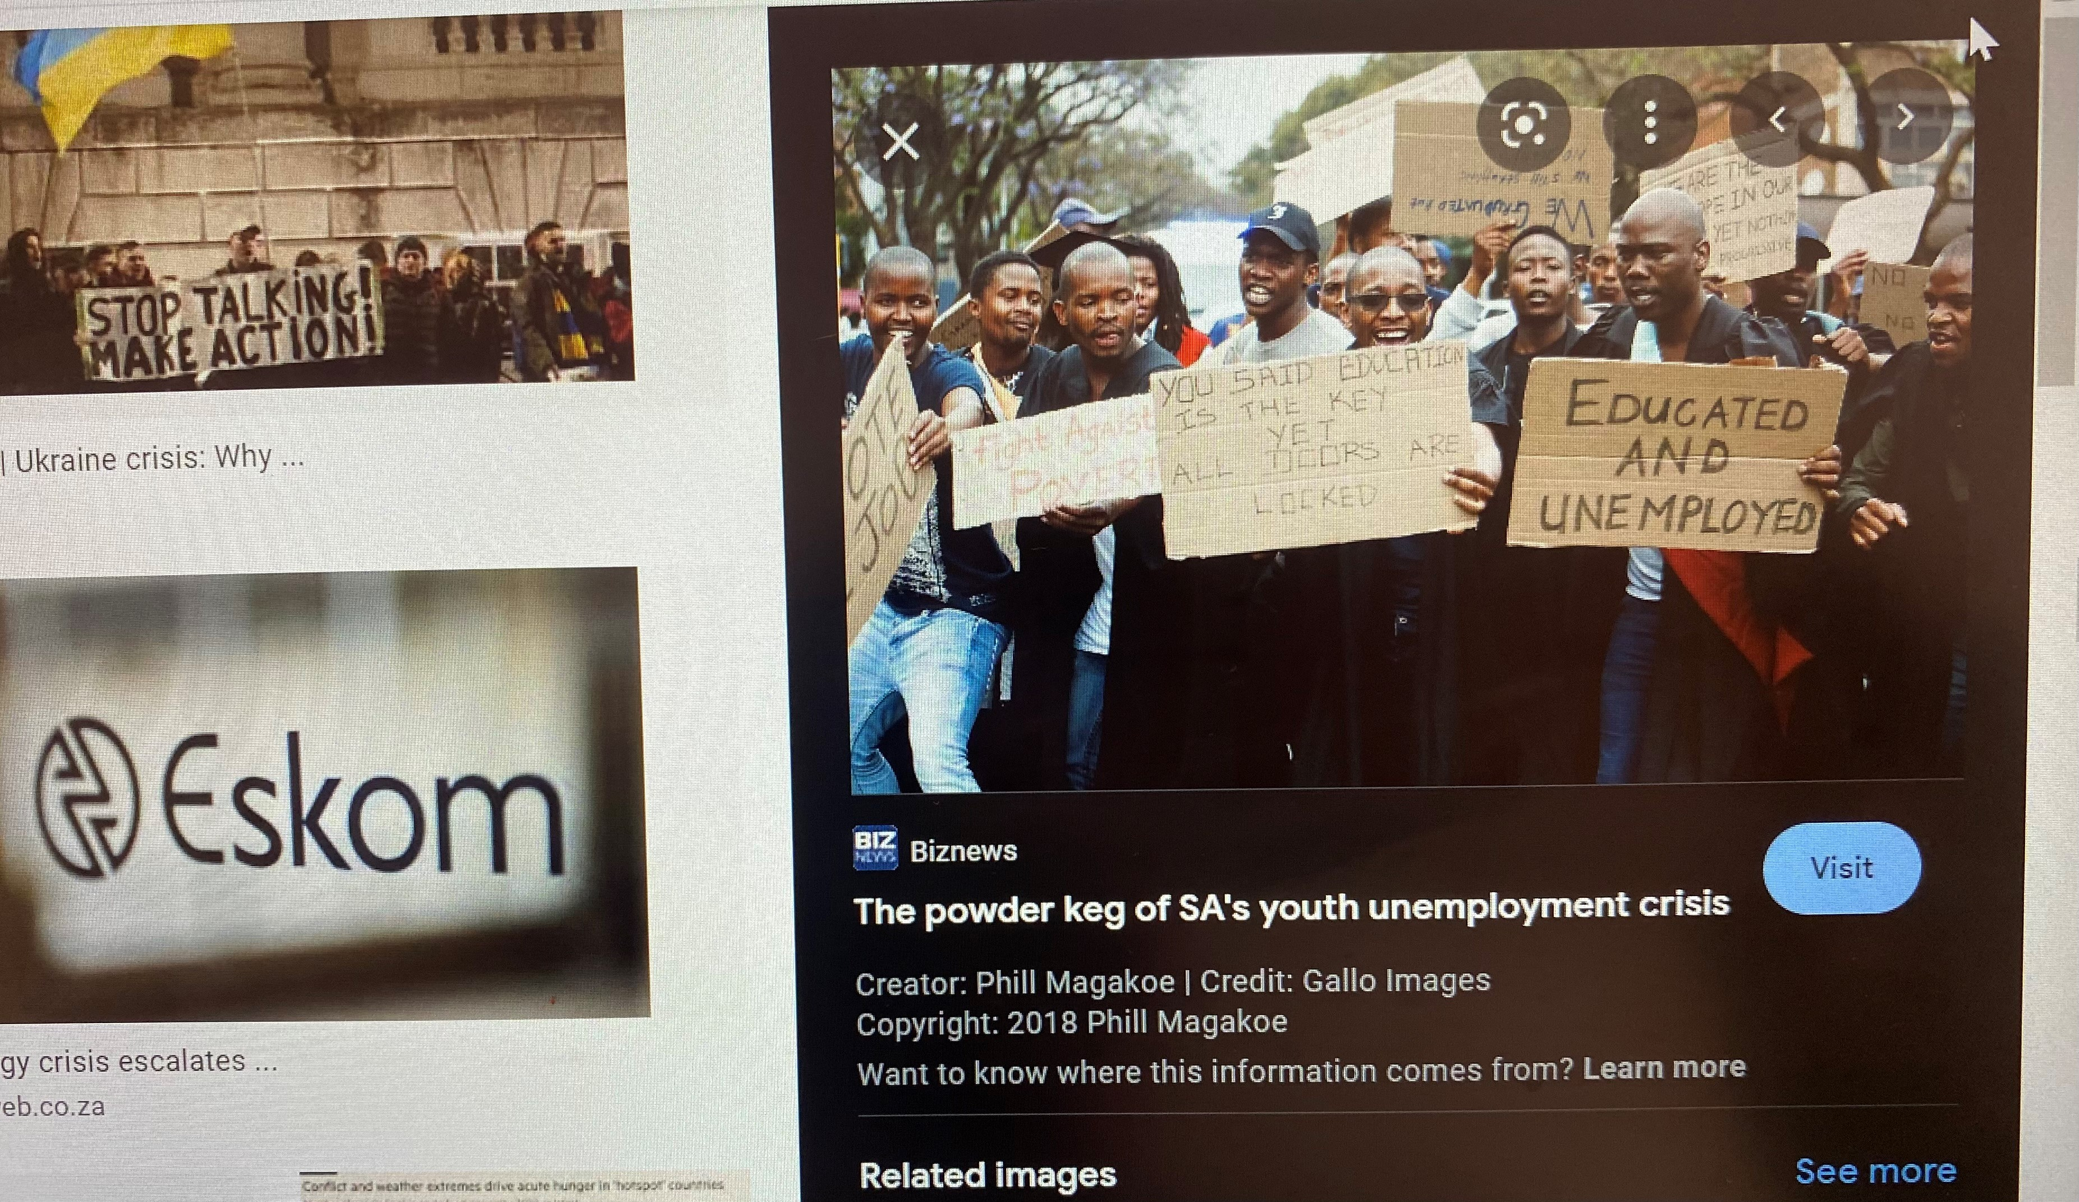
Governance and oversight in a polycrisis and permacrisis age characterised by extreme Volatility, Uncertainty, Complexity and Ambiguity (VUCA)requires ensuring strategic delivery on current needs unimpeded by maladministration, self interest and corruption while anticipating and skillfully anticipating and bending the future in line with government’s constitutional responsibilities, commitments and societal vision undergirded by competent and impactful oversight and related accountability. When you do not know where you are going and have none or weak guardrails to keep you on track the winds will take you anywhere (Need for a Lighthouse Approach : 4 PPPPs Approach)
PUBLIC GOVERNANCE & IN A POLYCRISIS – PERMACRISIS AGE

Slide 6
OVERSIGHT UNDER CONSTITUTUTIONAL GOVERNANCE GUARDRAILS
“Our Constitution has a transformative mission. It hopes to have us reimagine power relations within society. In so many ways, it enjoins us to take active steps to achieve substantive equality, particularly for those who were disadvantaged by past unfair discrimination” Moseneke DCJ, in South African Police Service v Solidarity OBO Barnard
KEY QUESTION SHOULD BE: GOVERNANCE FOR WHOM AND TO WHAT END? Our Constitution and international normative standards enjoin us to govern democratically for justice, equity and inclusive development (Social Justice). In “Making Social Justice Real”(Boggenpoel, 2022) I outline our Constitution’s remarkable transformative architecture.
Vision of Society(Preamble) Includes establishing a society based on social Justice.
Character of the State(s1, 96, 136,195 &237): Ubuntu (Makwanyane), achievement of (substantive equality,(Van Heerden) freedom (PE Municipality), human dignity(Mahlangu),Ethics, accountability & constitutional supremacy(Nkandla case)
People’s basic entitlements (Note full menu for all including freedom from hunger)
Structure of Government and Polycentric Accountability Framework (Beyond Trias Politica – includes Chapter 9 Institutions +Statutory Oversight & Compliance Institutions
Global Guardrails (Ch.14|s231-233)Copenhagen Declaration, SDGs , AU Agenda 2063 & SADC Protocol on Gender & Dev - Not in Making Social Justice Real)
Poor oversight and non-compliance undermine social justice directly and indirectly.

Slide 7
OVERSIGHT UNDER CONSTITUTIONAL GUARDRAILS
UN 8 Principles of Governance
1. Participatory;
2. Consistent with the rule of law;
3. Transparent;
4. Responsive;
5. Consensus-oriented;
6. Equitable and inclusive;
7. Effective and efficient; and
Accountable (Rothstein and Teorell, 2008; UN, 2009). These resonate with s195 of the Constitution
Admin Justice Principles provide further guiderails that must be taken with the rest of the Constitution, particularly s 195 and the Bill of rights:
Lawful
Reasonable
Fair (Procedural)
Written reasons
Rational (Bato Star Fishing (Pty) Ltd v Minister of Environmental Affairs and Tourism and Masetlha v President of the RSA and other cases)

Slide 8
OVERSIGHT UNDER CONSTITUTIONAL GOVERNANCE GUARDRAILS
Governance for Justice, Equity and Diversity is governance for social justice and sustainable democracy and South Africa’s constitution, which is a transformative blueprint adopted by the people of south Africa to-
“ Heal the divisions of the past and establish a society based on democratic values, social justice and fundamental human rights” ( Preamble) where every citizen’s life is improved and every person’s potential is freed within a specific framework of people’s entitlements, character of the state and polycentric accountability framework. Key applicable constitutional governance guardrails include:
Ethical Governance: s195 read with s1, s96 and s136
Democratic Governance: See s33 read with PAJA and Chaptere9
Advancing Social Justice: Preamble plus Bill of Rights in Ch. 2 Read with International Human Rights Treaties plus international soft law such as the Beijing Platform for Action (BPA), Durban Declaration on Racism, Copenhagen Declaration on Development, SDGs and Agenda 2063. NB of the 8 UN Principles of Good Governance
Advancing Human Rights: Preamble, s1 and Ch.2

Slide 9
THE MEANING AND THEORETICAL UNDERPINNINGS OF SOCIAL JUSTICE
At the CSJ we understand social justice as justice concerned with embracing the humanity of all through equal enjoyment of all rights and freedoms by all regardless and mindful of human diversity expressed through just, equitable and fair distribution of all opportunities, resources, privileges, benefits and burdens in and between societies.
Social justice originated as an economic equity concept in the 19th century coined by Italian Jesuit philosopher Luigi Taparelli(1840-3) who coined the concept of social justice around in response to the unconscionable economic and social reality witnessed just after the first industrial revolution. The concept was further developed and integrated in legal theory and constitutional law by another Italian theological philosopher Antonio Rosmini (Rosmini,1847). At the end of World War I global leaders embraced and gave content to the concept of social justice in the Treaty of Versailles in 1919, which established the ILO to serve as a custodian of social justice.
American philosopher John Rawls popularized and developed the concept of social justice further in his A Theory of Justice (1971 – 91), where he placed fairness at the centre of justice and presented social justice as justice between social groups within and between societies. Indian economist Amartya Sen further developed the concept of social justice, highlighting its capabilities dimension.
The SA Constitutional Court has embraced social justice as a dimension of Ubuntu (Madala J in Sv Makwanyane, 1995) and a constitutional imperative (Langa J in Investigation Directorate: Serious offences and Others v Hyndai Motor Distributors (Pty) Ltd, 2000), which has a restitutive dimension (Moseneke J in Minister of finance v Van Heerden, 2004.)
Quote Grootboom

Slide 10
POLYCENTRIC OVERSIGHT AND ACCOUNTABILITY INSTITUTIONAL ARRANGEMENTS AND RESPONSIBILITY AREAS
d
INTITUTION | NATURE OF ACCOUNTABILITY | AREAS OF RESPONSIBILITY | SOCIAL JUSTICE IMPLICATIONS
PARLIAMENT | POLITICAL | Ethics, Good Administration(Includes Implementation of Laws , Anticorruption, Social Justice Human Rights | YES
EXECUTIVE | VARIED | Incudes regulating civil society conduct | YES
JUDICIAL SYSTEM ( Includes NPA) | JUDICIAL/LEGAL | Constitutional Compliance, Justice Administrative Justice ( Includes ethics) and span of control includes all | YES
PUBLIC PROTECTOR | ADMINISTRATIVE | Proper conduct in state affairs, mainly i good governance focusing on anticorruption, ethics, maladministration and service delivery | YES
AUDITOR GENERAL | ADMINISTRATIVE | Primarily proper resource utilization and related rules compliance | YES
Human Rights| Gender| CRC Commissions | ADMINISTRATIVE | Human rights and equality related inclusive of civil society | YES
PUBLIC SERVICE COMMISSION | ADMINISTRATIVE | Public administration mostly human resources rights and conduct | YES
MEDIA & CIVIL SOCIETY | SOCIAL ACCOUNTABILITY | State affairs, civil society and global governance | YES

Slide 11
STATE OF COMPLIANCE
INTITUTION | NATURE OF ACCOUNTABILITY | AREAS OF RESPONSIBILITY | STATE OF COMPLIANCE RED FLAGS | SOCIAL JUSTICE IMPLICATIONS AND PROPOSED REMEDIAL ACTION
PARLIAMENT | POLITICAL | Ethics, Good Administration(Includes Implementation of Laws , Anticorruption, Social Justice Human Rights | State Capture Follow through Lacking Executive Not held to account for non-implementation of Acts of Parliament and for constitutionally incongruent fiscal policy choices often contradicting presidential commitments Protection of Non-Political Oversight Institutions Needs rebooting for constitutional compliance | New law needed to hold active to account as its actions have cost the country on asocial justice Consider a joint committee to periodically review all Transcend the complaints driven paradigm and embrace purpose driven
EXECUTIVE | VARIED | Includes regulating civil society conduct | Inadequate monitoring of business sector especially informal sector and mining license compliance Inadequate monitoring of legislation implementation and revue | Annual complaints review report discussed with Parliament Better leveraging of SALRC and NSG Leverage digitized prospective impact tools such as SIAM and Mapping.
JUDICIAL SYSTEM ( Includes NPA) | JUDICIAL/LEGAL | Constitutional Compliance, Justice Administrative Justice ( Includes ethics) and span of control includes all | Good compliance with judgements by other branches Slow and concerning STDs regarding prosecution of state capture cases Concerns regarding class disparities implications of private prosecutions (PPS) | NPA to establish what stops or sabotages some prosecutions and SOPs that standardize investigation process including when arrests are to be made and matters enrolled Review law of PPs
PUBLIC PROTECTOR | ADMINISTRATIVE | Proper conduct in state affairs, mainly i good governance focusing on anticorruption, ethics, maladministration and service delivery | Improving compliance by organs of state but litigation trend still concerning given no legal aid is set aside for Gogo Dlaminis to remain part of their own causes | Review Public Protector Act to further clarify place in access to administrative justice & access
AUDITOR GENERAL | ADMINISTRATIVE | Primarily proper resource utilization and related rules compliance | Concerns that irregularities are growing rather than declining, key concern being social justice implications of the slowing of service delivery in addition to resource theft through corruption and fraud | Leverage NSG to train those responsible for lapses and reconsider use of criminal law for non-criminal conduct as it encourages masking.
Human Rights| Gender| CRC Commissions | ADMINISTRATIVE | Human rights and equality related inclusive of civil society | Concerns regarding no-n compliance, including failure to implement Chapter 5 of the Equality Act despite SAHRC directive in 2010 and massive derailment of advancement of social justice | Consider a Venice styled Commission that feeds parliament on latest jurisprudence and systemic implications Make failure to implement without cause a punishable ethical violation
PUBLIC SERVICE COMMISSION | ADMINISTRATIVE | Public administration mostly human resources rights and conduct | Slow processing of HR cases with massive implications for financial wastage, vacancies and related service disruption affecting mostly those who absolutely rely on government services | Same as SAHRC Factor ethics in recruitment Emphasis on ethical gov training, incl. justice and conflicts of interest.
MEDIA & CIVIL SOCIETY | SOCIAL ACCOUNTABILITY | State affairs, civil society and global governance | Active investigative media ‘s key results but polarization and partisan trends might put pressure on some and none on others. Also social accountability tends to be flare-up oriented e.g. state capture | Citizen compacts supported by Constitutional and Legal literacy plus gov tech powered transparency tools such as block chain
d

Slide 12
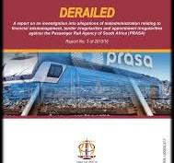
STATE OF OVERSIGHT, COMPLIANCE AND IMPLICATIONS FOR SOCIAL JUSTICE
Mindless oversight is not oversight and does not foster accountability as contemplated in the Constitution. Oversight should not just check that rules are complied with. Equally important is ensuring that public governance progressively transforms South Africa from the country that was inherited into the society envisaged in the Constitution. This goes beyond stopping Gimbas from gobbling public resources and includes ensuring that all laws, policies and programmes are aligned to the transformative governance ethos in the Constitution at the heart of which is the advancement of democratic governance, social justice and fundamental human rights for all.
The Thuma- CSJ titled THE CONSTITUTION, PEOPLE’S PRESSING HUMAN RIGHTS NEEDS AND POLITICAL PARTY PRIORITIES : A MATCH OR DISSONANCE lays bare the fact that despite our progressive constitution, laws, programmes and massive social investments democracy is not working for many and has not transformed the pyramidic structure of the inherited colonial-apartheid economy and that this has a radicalizing effect in addition to legitimizing violations of the rule of law.
Oligarchy is not democracy the replacement of one oligarchy with another will not yield constitutional objectives and as a result will not save South Africa from degenerating further into oligarchy steeped in demagoguery, leading to more rejection of the Constitution as a Potemkin charade and of democracy as having no merit

Slide 13
CONSTITUTIONAL GOVERNANCE ATTUNED OVERSIGHT AND LEADERSHIP THROUGH THE EPIC LEADERSHIP CODE
Leadership: Who will my action influence and inspire to think and act in a particular way to achieve what?
Ethics: Is this the right thing to do and the right way to do it? NB to think of right and wrong as concepts with plasticity and which transcend obvious wrongs such as dishonesty, corruption, including state capture, and fraud and includes fairness and social justice. This requires a beyond just us leadership ethos.
Purpose: What is the purpose of my action and is it aligned to relevant purposes?
Impact Conscious: What will be the impact on my life, family, organization, others and the environment now and in years to come?
Commitment: Is this aligned to my commitment to serve all beyond justice as “just us” and will the applause within be enough

Slide 14
SOME THOUGHTS ON RETHINKING PUBLIC GOVERNANCE, OVERSIGHT AND COMPLIANCE
Place Constitutional Governance at the Centre, particularly the three goals of constitutional governance that are democratic values, social justice and fundamental human rights
Oversight to do more than stopping maladministration, Integrity related ethical violations ( Gimbas) and put the purpose of public governance and recentre understanding that at the core of such is transformative governance
Adopt a systems thinking approach to oversight and accountability focussing on planning and monitoring for transformative governance, service and anchoring trust.
Leverage technology, including block-chain technologies to promote transparency and leveraging data analytics for anticipatory impact conscious policy design tools such as SIAM and equity mapping to limit impropriety and foster equity and ultimately social justice.
Cultivate ethical leadership, Including through growth mindset and administrative justice culture, key being positional leaders and top structures walking the talk on oversight and compliance.

Slide 15
GRATITUDE
Failure can be a great teacher for those that are willing to learn
E Nkosi!
Dankie!
Thank you!
Asante Sana
tmadonsela@sun.ac.za

